Slide 1

Top 5 categories of Social Media Buzz
Notes:
Hello and Welcome. My name is Franklin Obiefule and today, I will be presenting to you the results for the Data Analytics task on the insights for Top 5 Categories of Social Media Buzz.

Slide 2
Todays Agenda
Project Recap
Problem
The Analytics Team
Process
Insights
Summary
Notes:
Today’s agenda will be as follows:
We will recap the overall project to give a high level understanding of the business problem we’re tackling and the specific requirements.
We will dive into the specific problem that we, the Data Analytics team, have been focusing on and will give some background as to why this is such a big problem.
After introducing the problem, I will go over the team responsible from our side in tackling this task.
I will then go over the high-level process that we followed to complete this task, so that you have complete clarity on how we tackle these kinds of tasks.
Finally, I will go over the important results and present them as a series of insights and visualizations from our analysis.
To wrap up, I will summarize and open for any questions

Slide 3
Project Recap
Social Media Buzz, a social media and content creation company needs an advisory expertise to oversee their scaling process effectively.
ACCENTURE aims to achieve 3 main objectives:
Audit of their big data practice
Recommendations of a successful IPO
Analysis of content categories that highlight the top 5 categories
Notes:
We, Accenture, have embarked on a 3 month pilot with Social Buzz to focus on 3 main tasks, aligned with some of the biggest challenges that you’re currently facing.
Social Buzz has reached huge scale in recent years to become recognized as a global unicorn company. We are here to help you manage this scale and guide you in the right direction.
Firstly, we will be doing an audit of your big data practice and sharing best practices and industry experiences. Secondly, we will be guiding you through a successful IPO of which we have deep expertise and knowledge of within our team. Finally, we have conducted an analysis of your data to find insights regarding your top 5 popular content categories.

Slide 4
PROBLEM
100,000 daily content
3m monthly content
500m active users monthly
Notes:
Focusing on the last point I mentioned in the last slide, this is what the Data Analytics team has been specifically focused on.
Clearly with such grand scale, this comes with lots of data and with such vast amounts of data comes challenges.
To give a background on how much data you’ve been creating:
-You told us that your platform receives over 100,000 daily posts which amounts to 3m posts monthly and 36.5m posts annually, of which, this is all unstructured data making it very hard to make sense of.
In this day and age, content is king. Look at some of the biggest global content platforms like Youtube, Facebook, Netflix etc… Their major forte is content business.
How can we capitalize on it where there is so much?
Its not just all about harvesting as much content as possible. The real value is in understanding and crunching the content to gain a deeper understanding of your audience and to therefore provide a more personalized and enjoyable experience.
This is where our data analytics experience comes in, with the insights that we’ve uncovered from this task. We can show you exactly how to take analytics to scale production.

Slide 5



THE ANALYTICS TEAM Andrew Fleming Chief Technical Architect
Marcus Rompton
Senior Principal
Franklin Obiefule
Data Analyst
Notes:
Talking about experience, we have a large data analytics staff at Accenture but we had a team of 3 people primarily focusing on this task.
Andrew Fleming is our Chief Technical Architect and his expertise really helped to guide the team to produce high quality analysis.
Marcus Rompton, a Senior principal, has worked with the world’s biggest clients on solving their data problems and was heavily involved in the data engineering side of this project.
Myself, Franklin Obiefule, who was solely responsible for taking leadership guidance and delivering high quality insights from the raw datasets and turning them into business decisions.

Slide 6
PROCESS
DATA UNDERSTANDING
DATA CLEANING
DATA MODELLING
DATA ANALYSIS
DISCOVER & PRESENT INSIGHTS
Notes:
How did we tackle the problem?
Well, we approached it in 5 steps:
Data Understanding- the key to success in any data project is to understand the data in detail. So we took time to understand the data model and domain of your business.
Data Cleaning- We cleaned the available datasets and thought about what an ideal dataset should look like for this problem.
Data Modelling- After ensuring the data was clean for analysis, we needed to model and process this data into a dataset that can precisely answer the business questions and produce the results needed.
Data Analysis- With our new dataset, we used our analytical expertise to uncover insights from this dataset and produce visualizations that describe the insights.
Finally, we used these insights to unlock business decisions and make recommendations for next step.

Slide 7
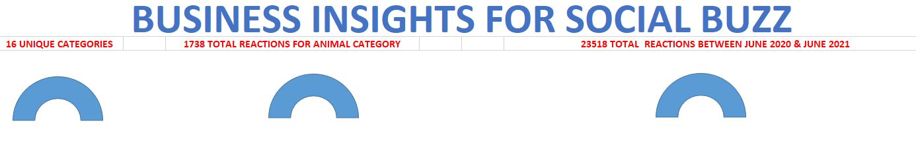
INSIGHTS
Notes:
From dataset, we discovered that you had 16 unique categories of posts across your sample dataset. This includes things such as Food, Science and Animals.
Also, the animal category had the highest number of reactions, 1738! People obviously like animals.
The total reactions between June 2020 and June 2021 is 23518 averaging 1809 reactions per month.

Slide 8
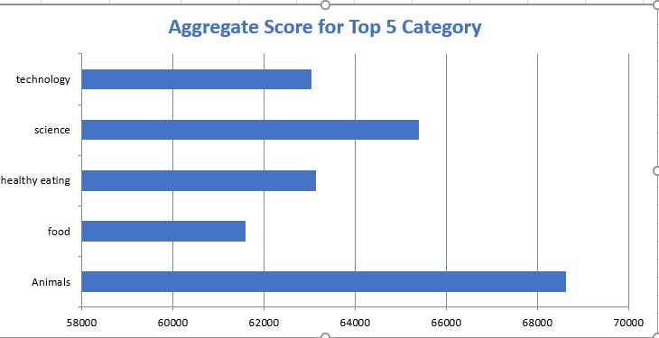
INSIGHTS
Notes:
From our analysis, you can see that the top 5 category of posts were animal, food, healthy eating, science and technology.
Animals had an aggregate popularity score of around of 68,624. It is also interesting to see both food and healthy eating within the top 5. It really shows food is a highly engaging content category. Healthy eating ranks slightly higher than food, so perhaps your user base may be skewed towards healthy eaters and health conscious people.
Finally, its also interesting to see science and technology too. This may suggest that people enjoy consuming factual content and snippets of content that they can learn something from.

Slide 9
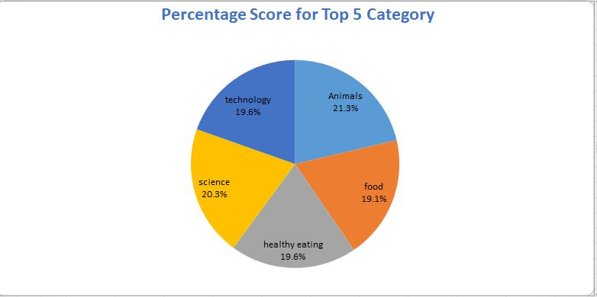
INSIGHTS
Notes:
You can see from this pie chart that the percentage difference between the top 5 categories is quite little. The difference between the most popular category, Animals, and the second most popular category, science, is the largest gap which equals 1%.
In business terms, this could suggest that the most popular category, animals, is tailing away from the rest of the categories and may continue to get more and more popular. To avoid an issue where 1 content category consumes the entire platform, it will be important for you to ensure that any algorithm used to govern the content on the platform gives a fair balance to the content categories.

Slide 10
ANALYSIS & INSIGHTS
Animals and science are the top 2 categories showing people enjoy “real-life” and factual content.
Since food and healthy eating are among top 5 categories, a campaign with food and healthy eating brands could boost user engagement.

Slide 11
SUMMARY
Animals and science are the top 2 categories showing people enjoy “real-life” and factual content.
Since food and healthy eating are popular categories, insights from this could be used to boost engagement. For example, you could run a campaign with content focused on this category or work with healthy eating brands to promote content.
We are ready to take it to the next stage and we have the expertise within Accenture to help you realize these kind of insights in production across your organization and in real time. We would love to help you with this.

Slide 12


